Slide 1
Coverage of the war in Ukraine. ONO shop talk, March 9, 2022
Tarmu Tammerk, Ombudsman, Estonian Public Broadcasting (ERR)

Slide 2
Russia wants change of terms
Not war, but “special military operation”
Mandatory in media and anywhere else
Tolstoy’s novel “War and Peace”?

Slide 3
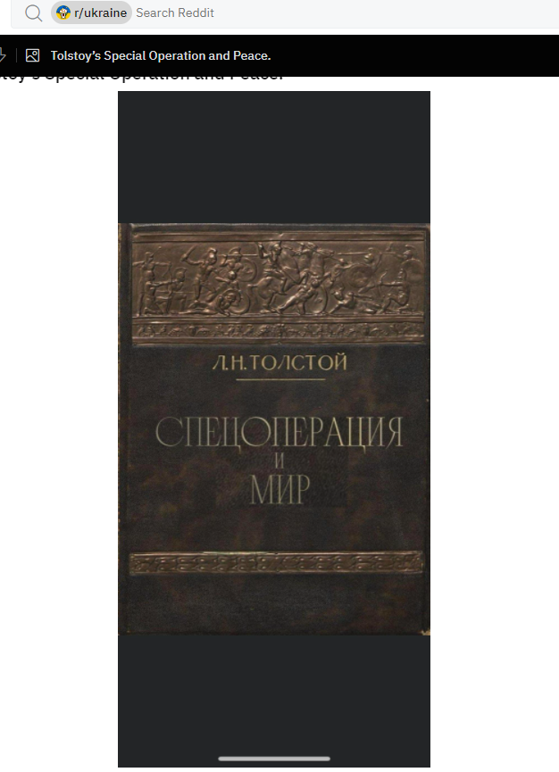

Slide 4
Basis for coverage at ERR
Russia started war against Ukraine
This is an unacceptable crime

Slide 5
Russia blocks ERR News in Russia
Russian state media regulator Roskomnadzor told ERR on Day One of the war (Feb 24) to delete a news story or the ERR’s Russian-language news portal would be taken offline in Russia
The story was a news bulletin about Ukraine’s foreign minister announcing that Russia had launched a full-scale war against the country.

Slide 6
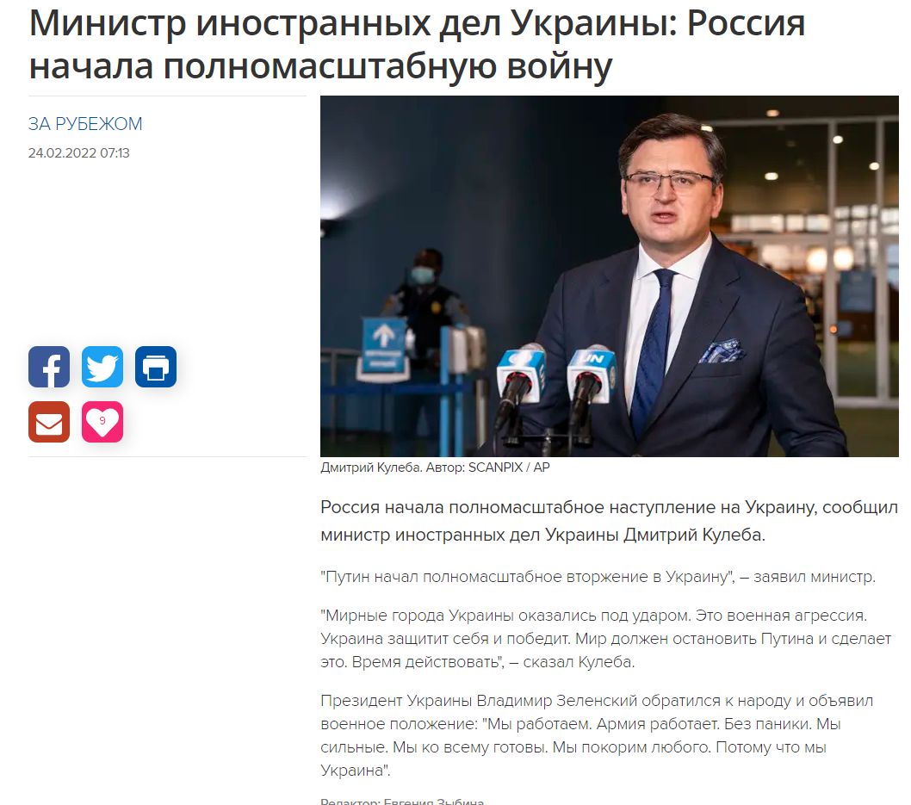

Slide 7
The explanations by Roskomnadzor
Roskomnadzor said the article contains “false messages about terrorist attacks or other kind of information of public concern disseminated under the guise of reliable information that threatens life and (or) health of citizens” etc – quotes from law

Slide 8
Article not removed
ERR didn’t remove the article https://rus.err.ee/1608510803/ministr-inostrannyh-del-ukrainy-rossija-nachala-polnomasshtabnuju-vojnu
On Feb 25, Russia made rus.err news portal unavailable in Russia

Slide 9
