Slide 1
Threats to and intimidation of journalists
- George Claassen
Public editor, News24 & Media24
Panel discussion: 1 June 2023, Annual Conference, Organization of Newsombudsmen & Standards Editors, London
Jon Williams (Committee to Protect Journalists)
George Claassen (News24, Media24, South Africa),

Slide 2
South African Constitution of 1996
Article 16: Freedom of expression
1. Everyone has the right to freedom of expression, which includes ­
a. freedom of the press and other media;
b. freedom to receive or impart information or ideas;
c. freedom of artistic creativity; and
d. academic freedom and freedom of scientific research.
2. The right in subsection (1) does not extend to
a. propaganda for war;
b. incitement of imminent violence; or
c. advocacy of hatred that is based on race, ethnicity, gender or religion, and that constitutes incitement to cause harm.

Slide 3
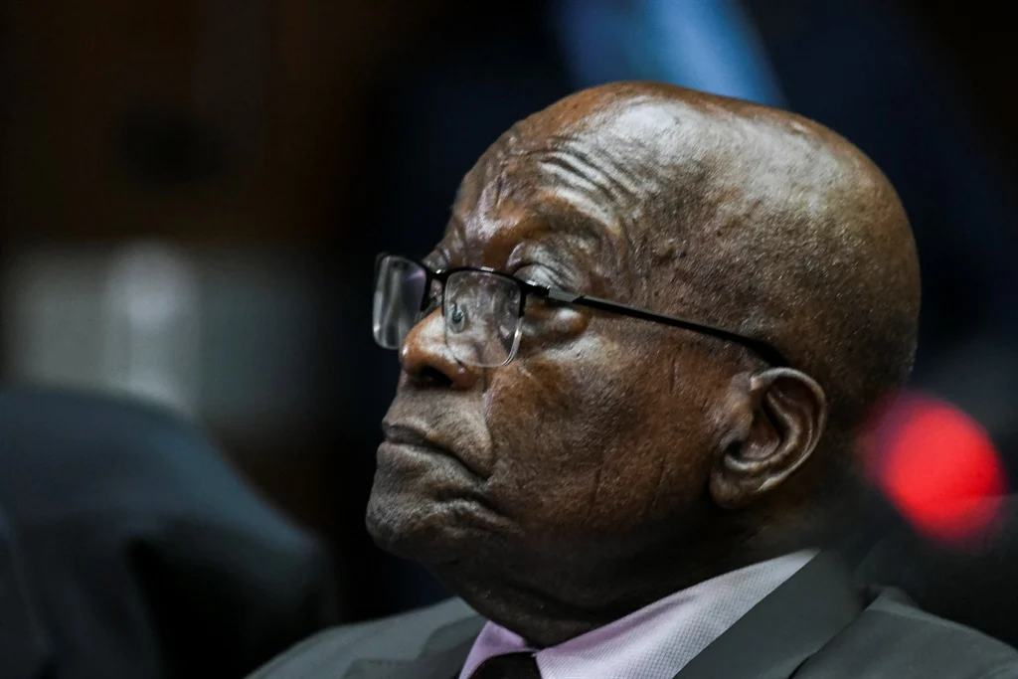
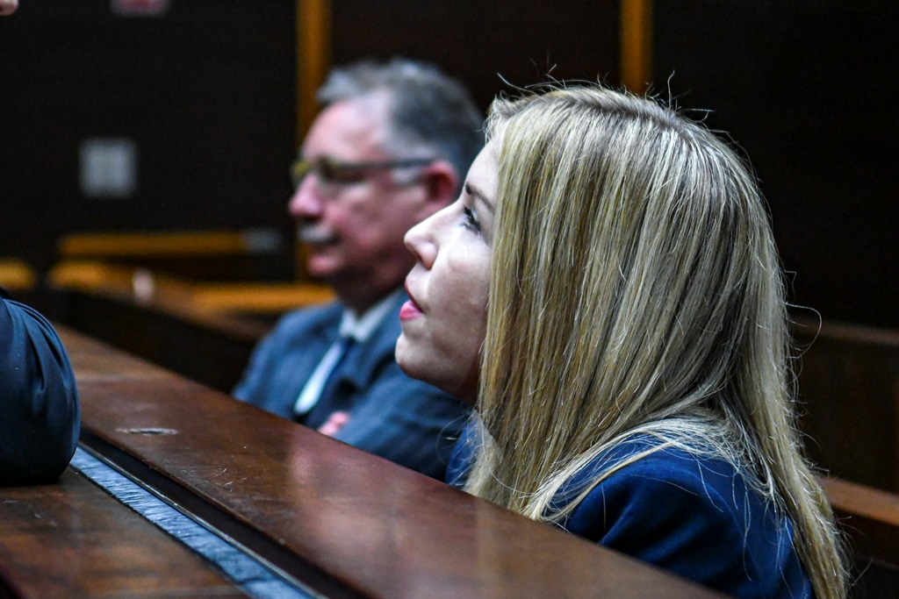
Private prosecution of News24 legal journalist Karyn Maughan
Former South African President Jacob Zuma in the dock on charges of corruption
News24 legal reporter Karyn Maughan charged in private prosecution by Jacob Zuma. In the back, Zuma’s prosecutor Billy Downer, also being charged in private prosecution by Zuma.

Slide 4
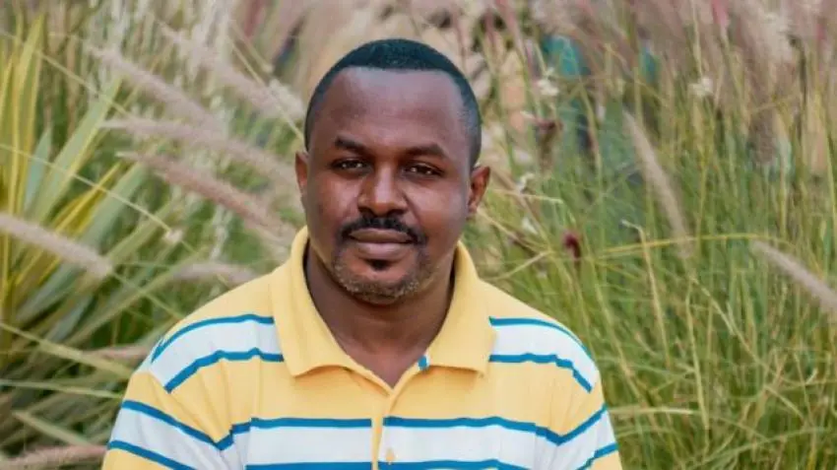
Rwanda: death of journalist John Williams Ntwali
Rwandan authorities should allow an independent, impartial, and effective investigation, drawing on international expertise, into the death of John Williams Ntwali, a leading investigative journalist, 90 civil society organizations and media associations said in a statement on 23 January 2023. Rwanda’s international partners should press the authorities to allow and cooperate fully with such an investigation.
Nothing happened.

Slide 5
Death of John Williams Ntwali
Ntwali played a leading role in covering and bringing attention to the plight of Kangondo neighborhood residents, who are in a long-standing dispute with the authorities over land evictions. At the time, he told Al Jazeera: “I'm focused on justice, human rights, and advocacy... the three are risky here in Rwanda.

Slide 6
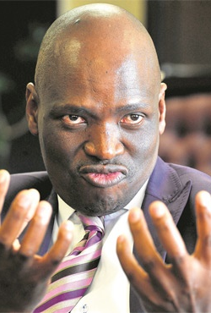
The SABC 8
Intimidation and intolerance led to firing of 8 SABC news reporters/editors who stood up against SABC CEO, Hlaudi Moetseneng, who put a ban on any reporting on protest marches and violence caused by these because of lack of service delivery.

Slide 7
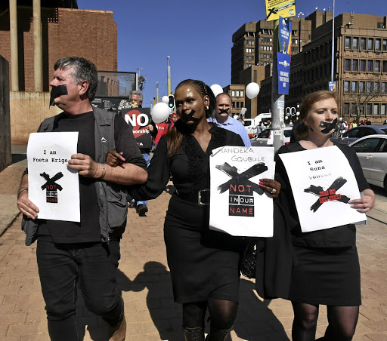
SABC 8
The late Suna Venter, Foeta Krige, Krivani Pillay, Thandeka Gqubule, Busisiwe Ntuli, Lukhanyo Calata, Vuyo Mvoko, and Jacques Steenkamp.

Slide 8
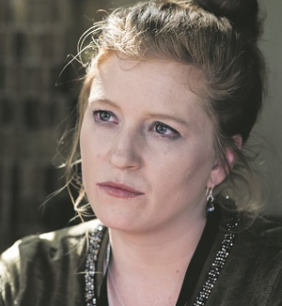
The SABC 8
Death of Suna Venter, Afrikaans journalist working for Radio Sonder Grense (Radio Without Borders). Intimidated by break-ins at her home, her car’s tyres slashed, being shot in the face, etc. Diagnosed with stress cardiomyopathy or "Broken Heart Syndrome", which could cause rapid and severe heart muscle weakness.

Slide 9
Moetseneng’s aspiration to SA Presidency
"South Africa is happy because I am ascending to the presidency of this country. We all know that Africa represents the continent, which is Africa.”
In 2019, after Moetseneng left the SABC, he founded his own political party, the African Content Movement (ACM). It contested the 2019 general election but received only 4 841 votes (0.03%).

Slide 10
Attacks & intimidation of SA journalists (2023)
2 March 2023: Newcastle Advertiser journalists Estella Naicker, Zianne Leibrandt and Mbali Butale:
Municipality mayor Xolani Dube and his deputy Sugar Thwala from the Inkatha Freedom Party accused Naicker “of being paid by the ANC to write negative stories about them”. They were covering the story of the Newcastle Resident’s Association (NRF) members filling potholes in their area. Phone taken and pictures deleted.
March 2023: “The South African National Editors’ Forum (SANEF) is horrified by growing trends of physically intimidating and harming journalists to stop them from reporting on important stories in the Eastern Cape.”

Slide 11
Attacks & intimidation of SA journalists (2023)
25 February 2023:
Reporting on the launch of Operation Manje Namhlanje - a crime prevention project by the City of Joburg's Public Safety department at Constitution Hill:
The South African National Editors’ Forum demands an immediate investigation from the authorities in Gauteng and KwaZulu Natal for the gross violations of the rights of an eNCA female reporter Silindelo Masikane and Zululand Observer reporter (pushed to the ground by members of the EFF) when she tried to interview MMC Mgcini Tshwaku.
April 2023:
The South African National Editors’ Forum (SANEF) has recently been inundated with complaints from journalists who are increasingly finding it increasingly hard to do their jobs when reporting on matters in court.

Slide 12
Attacking the messenger
The leader of the Economic Freedom Fighters, Julius Malema, spouting hate against mostly Asian and white South Africans. Calls them invaders and thieves who stole the land of blacks. His kicking out of BBC journalist at news conference while still leader of the ANC Youth League
https://www.youtube.com/watch?v=VFmVVd0NJBk

Slide 13
South African polemics challenging the media ombudsman, public editor, standards editor
Land reform
Article 25 of the Constitution under review that protects property rights. EFF proposes land to be confiscated without compensation, replacing the present system of land claims; ANC as ruling party also now investigating this possibility.
The Middle East
Israel/Palestine: 80 000 – 92 000 Jews in South Africa; Just more than a million Muslims in South Africa, the BDS activist group (Boycott Divestment Sanctions)
Science denialists

Slide 14
Personal attacks on media ombudsman, public editor, standards editor
I don’t know how you can even try and defend yourself. That News24 can ignore these racists (see the link) but give hysterical coverage to Sparrow, Momberg and Afriforum just tells me what a hypocrite you are. Tell me George, would you prefer someone to call you a monkey or would you prefer someone to threaten to kill you or “slit your throat”? News24 and the mainstream media are purely there to destroy white influence. It is a blatant fact. Which doesn’t say much for you as a person George, does it? I know everyone has their price but for me I would feel very uncomfortable going along with such glaring double standards so as to keep my job.
English-speaking white South African from Durban, Kwazulu-Natal province

Slide 15
Personal attacks on media ombudsman, public editor, standards editor
Some kind of ombudsman you are ? I will be escalating your comments to your board and all over social media and lets see how long you last. Oh I forgot your board consists of people who by virtue of their religion cannot be impartial and fair. All your editorial staff spend their time posting anti- Israel propaganda on their Facebook pages- How can they be impartial ? - But that my friend George is your job.
Businessman from Johannesburg

Slide 16
Denialism on science, attacking the messenger: Covid-19, climate change, evolution & creationism
“The only way in which Biology can be explained? You must be joking. This is the reason sharing differing views is important. So that you don't get trapped in your own emperical epistomology. A cursory look at creation.com shows that the creation/evolution debate has strong scientists with PhD's on both sides - no matter how much you quote the geneticist Theodosius Dobzhansky. The problem is the media can't decide on my behalf which cases are closed and which are open for debate. Saying the theory of evolution is a shut case and you shouldn't share the creationist point of view (regardless of how strong the debate might be raging in real life), is claiming that the media knows what is right and wrong.”
A comment on News24’s website after a public editor column, Fake news and the natural selection of ignorance (2018/03/23, https://www.news24.com/Columnists/GeorgeClaassen/fake-news-and-the-natural-selection-of-ignorance-20180323

Slide 17
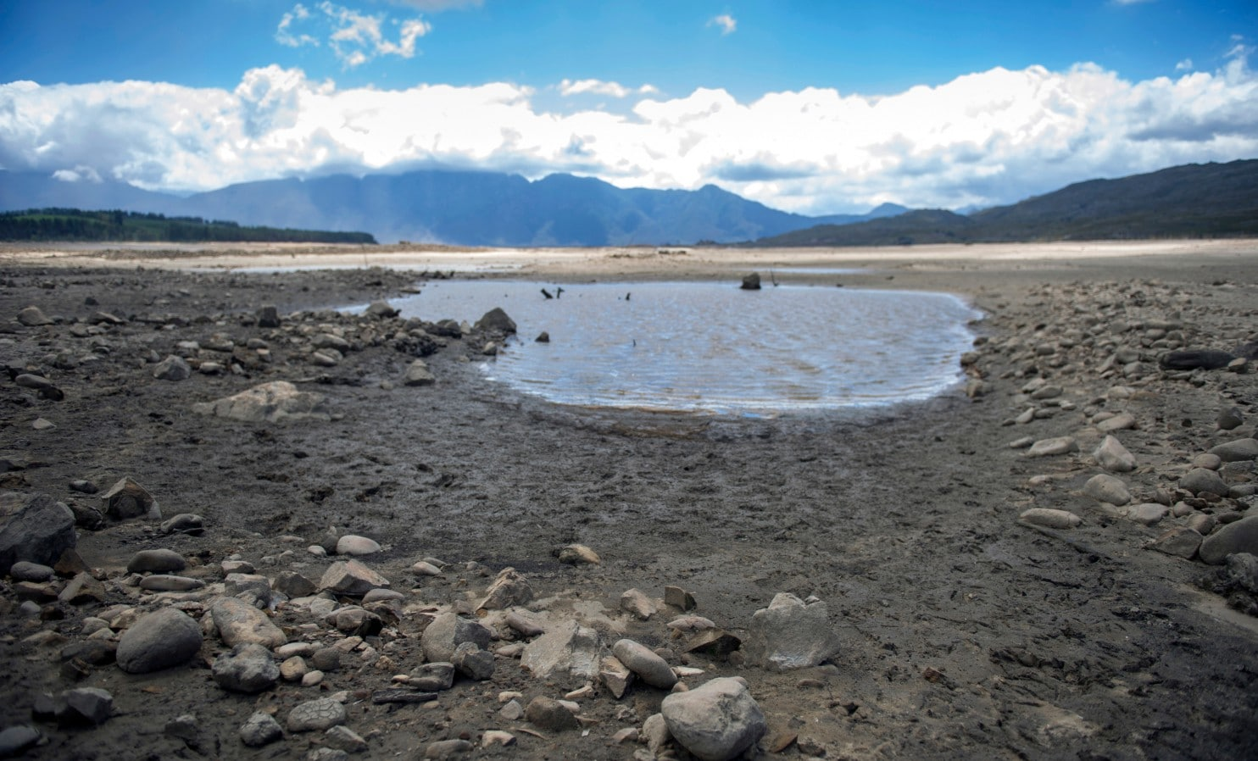
Denialism on science, attacking the messenger: Climate change

Slide 18
Denialism on science, attacking the messenger: Climate change
The water crisis in Cape Town and denialism by city’s inhabitants, politicians not trusting or believing scientists
IPCC’s warning in late 1990s that the Western Cape biosphere with its fynbos floral kingdom, will become semi-desert by 2050.
Journalists being blamed for scare-mongering about Day Zero

Slide 19
Denialism on science, attacking the messenger: quackery & health
Also for the record is the fact that Prof. Claasen (sic) , is the Director of the Centre for Science and Technology Mass Communication (CENSCOM), a spurious and new organisation established to influence the media to shun complementary and alternative medicine, and which is housed in the Department of Journalism in the Faculty of Arts and Social Sciences at Stellenbosch University. In November last year Prof. Claassen directed an International Summit to Counter Quackery, Pseudoscience and Fake News in Healthcare, which was a blatant smear campaign against the natural health industry.
Shame on you Claassen!

Slide 20
Refusing a platform to science denialists
GroundUp vs Joseph Winer March 2020, finding by the South African Press Ombud, later confirmed by the Press Council’s Appeal Panel:
On 15 March 2019 GroundUp (“appellant”) published an article with the headline: “Quack claims about oxygen treatment are dangerous.” The sub-headline read: “Hyperbaric oxygen therapy is used to cure ‘bends’ and treat several other conditions. But quacks are misleading the public about its use.”
The Press Ombud dismissed the complaint by Winer that he did not get the right to reply (audi alteram partem): the grounds for dismissal were that the article was based on accepted science and science reporting does not need to provide a platform when science denialism is clearly at stake; secondly, that GroundUp had taken the data from the respondent’s own website.

Slide 21
Refusing a platform to science denialists
This principle not to give science denialists with regard to Covid-19 a platform to spread conspiracy theories and fake news about Covid-19, was consistently applied by News24.
The same with regard to climate denialists:
“I am also very interested to see your increasing coverage of Climate
Change and your support for Renewable energy at the expense of fossil
fuels. I hope you apply the same rules of evidence regarding the
articles you publish on this subject. Or are you just going to keep
pushing the Climate Alarmism narrative regardless of the real evidence
that the increase in anthropogenic CO2 is miniscule and is not dangerous
but is in fact beneficial to plants and people. Also that there is no
evidence whatsoever that it is responsible for global warming or that it
creates adverse weather events.” (email to me and editor-in-chief by News24 reader, 25 May 2023).

Slide 22
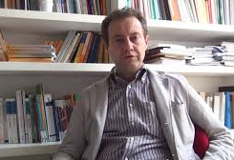
The media holding up a ‘dirty mirror’ of science
From the perceptive of scientists, “There has thus arisen a view of the media as a ‘dirty mirror’ held up to science, an opaque lens unable adequately to reflect and filter scientific facts.” – Massimiano Bucchi

