Slide 1
Journalistic Transparency & Trust
Jussi Latvala
Journalist Fellow, Reuters Institute for the Study of Journalism
Producer, Yle, The Finnish Public Broadcaster
jussi.latvala@yle.fi

Slide 2
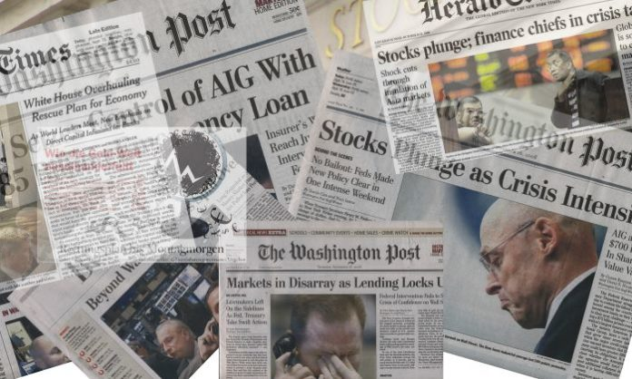

Slide 3


Slide 4
Transparency in practice?
Explaining why and how you did your reporting
Data journalism methodology
Providing additional information: recordings of your interviews, transcriptions, hyperlinks, datasets
Background information about the author
Inviting members of the public to the editorial meetings
Etc…

Slide 5
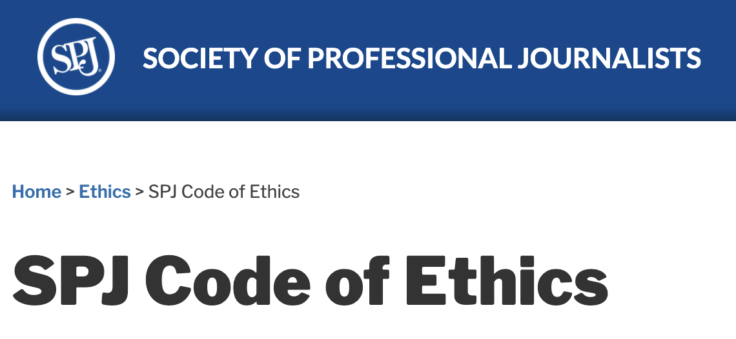
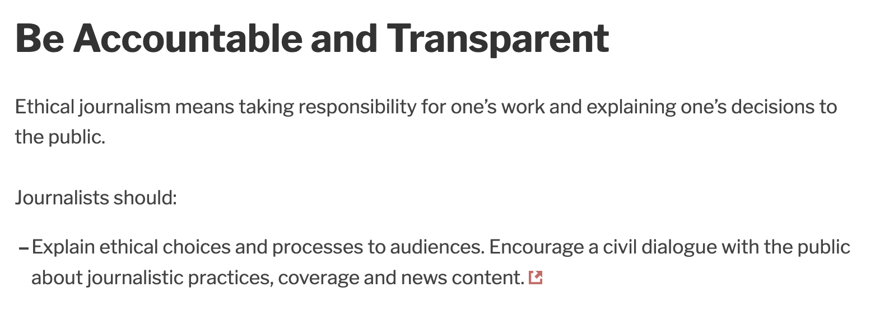

Slide 6
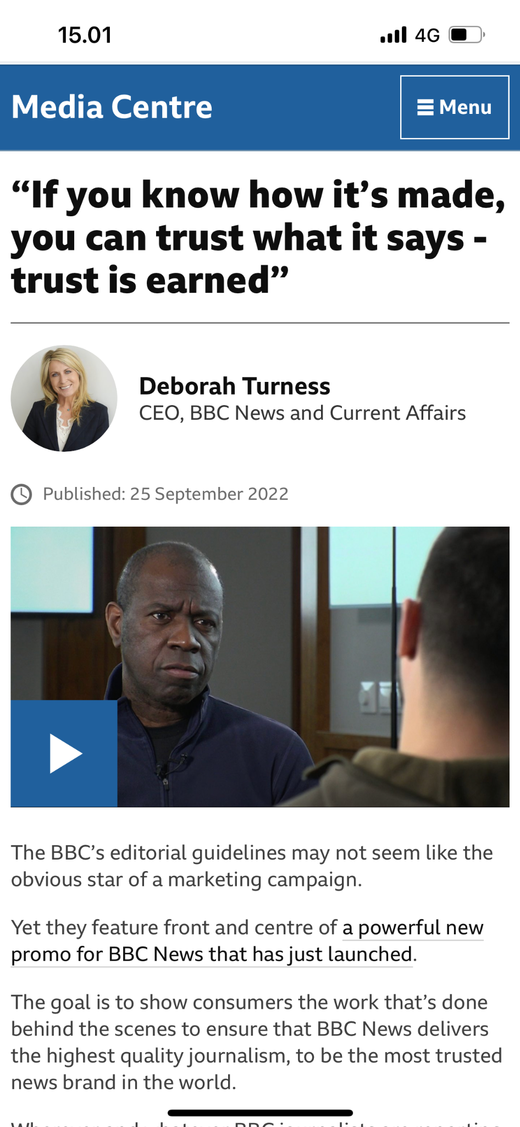
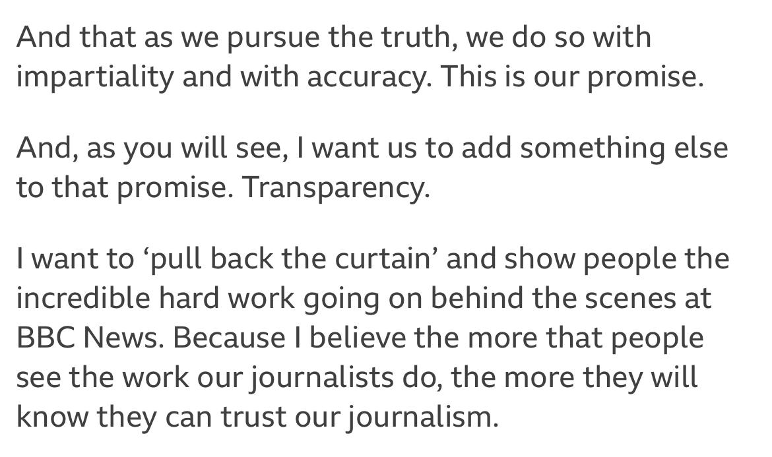

Slide 7
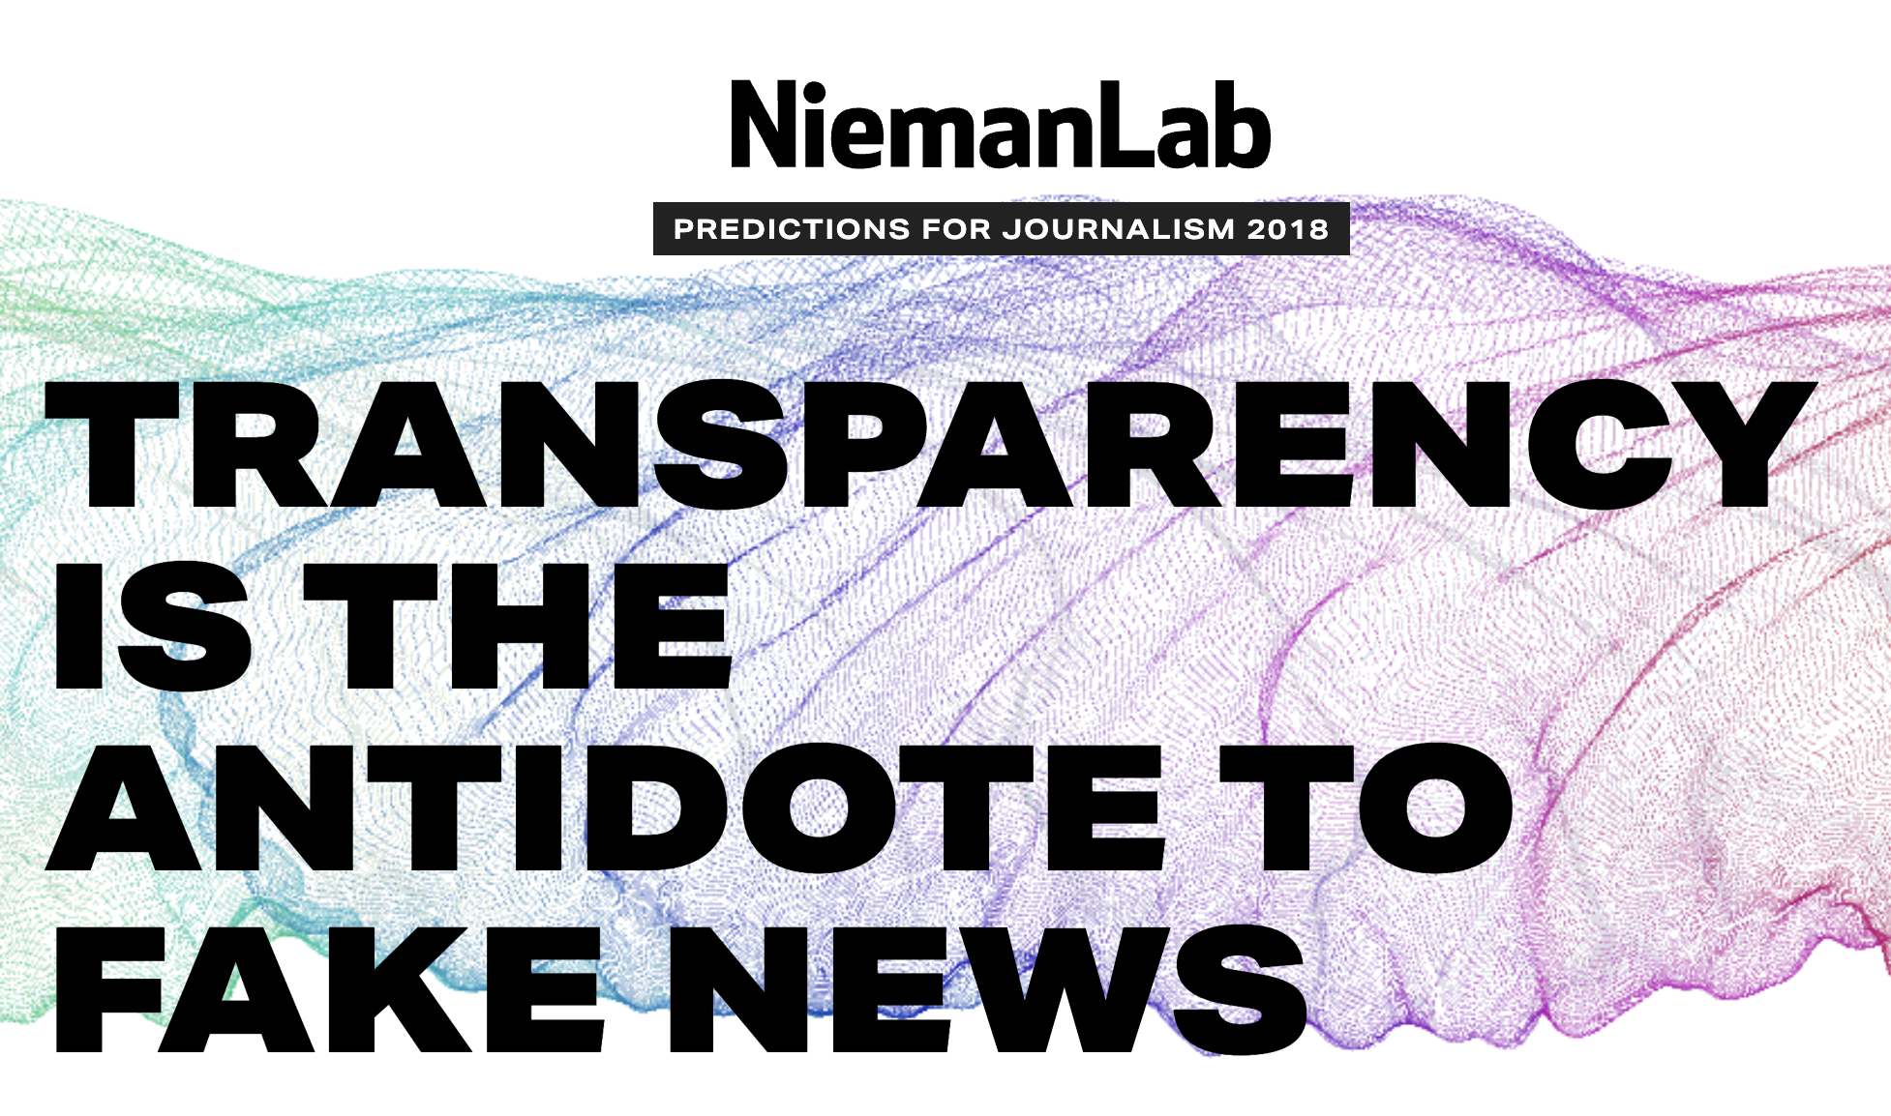
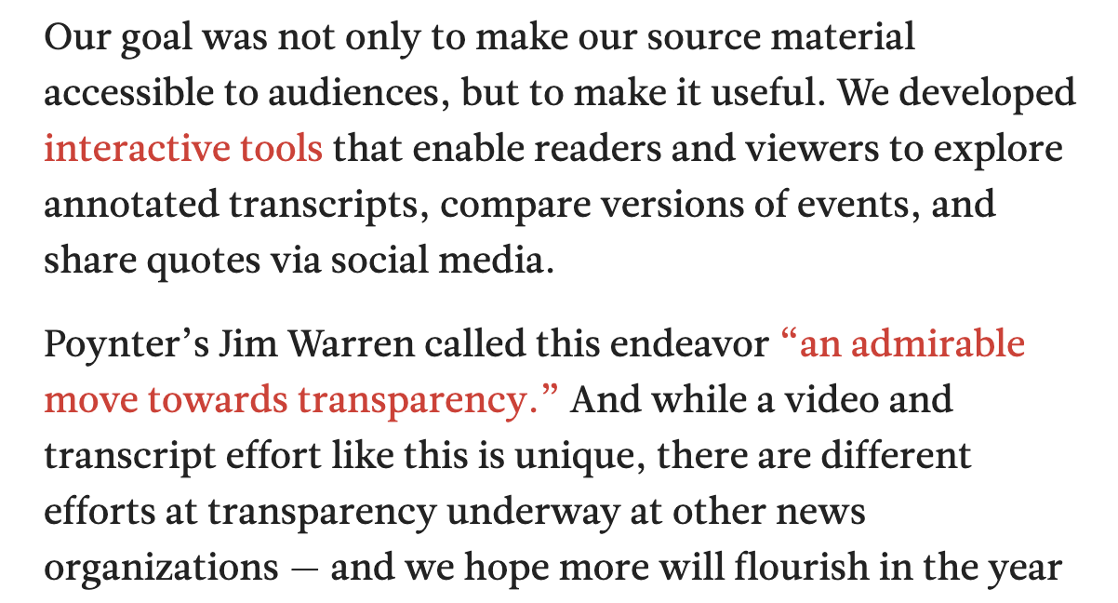

Slide 8

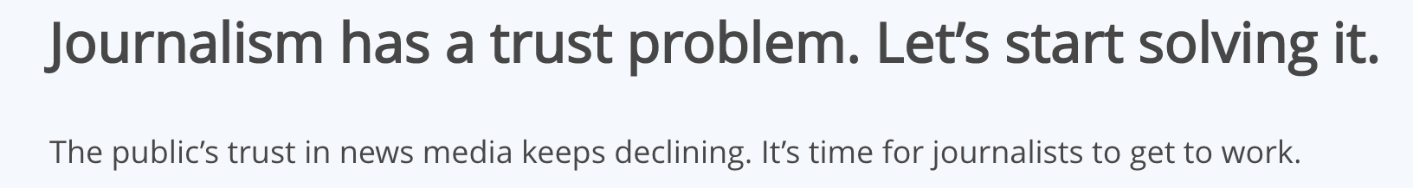

Slide 9
Journalistic transparency can increase trust from the audience.
When journalists are transparent about their sources, methods of gathering information, and potential biases, it helps to build credibility and trust with the audience.
By promoting transparency, journalists can enhance their relationship with the audience and strengthen trust in their work.
Source: Chat GPT, May 25

Slide 10
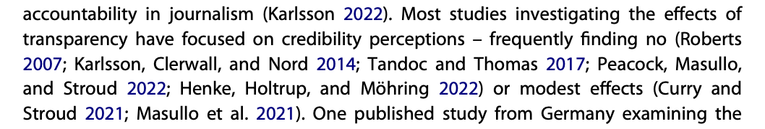
Koliska, Michael. "Trust and Journalistic Transparency Online." Journalism Studies (London, England) 23.12 (2022): 1488-509.

Slide 11
Why doesn’t it work?
Perceived dishonesty is not solvable by more information
Majority of the public is not interested in how the sausage is made
Making transparency engaging is not easy
Should we even want it…?
Transparency vs. trust

Slide 12
Trust is a psychological state comprising the intentions to accept vulnerability based on positive expectations of a trustee’s future actions, which cannot be controlled by the trustor.
(Mayer et al., 1995; Rousseau et al. 1998)
Trust is the willingness of the audience to be vulnerable to news content based on the expectation that the media will perform in a satisfactory manner.
(Hanitzsch et al. 2018)
Trust in news media is the individual’s willingness to be vulnerable to media objects, based on the expectation that they will perform a) satisfactorily for the individual and/or b) according to the dominant norms and values in society (i.e. democratic media functions)
(Fawzi et al. 2021)

Slide 13
Trust is being comfy with not being in charge while hoping that nothing bad will happen.
=)

Slide 14
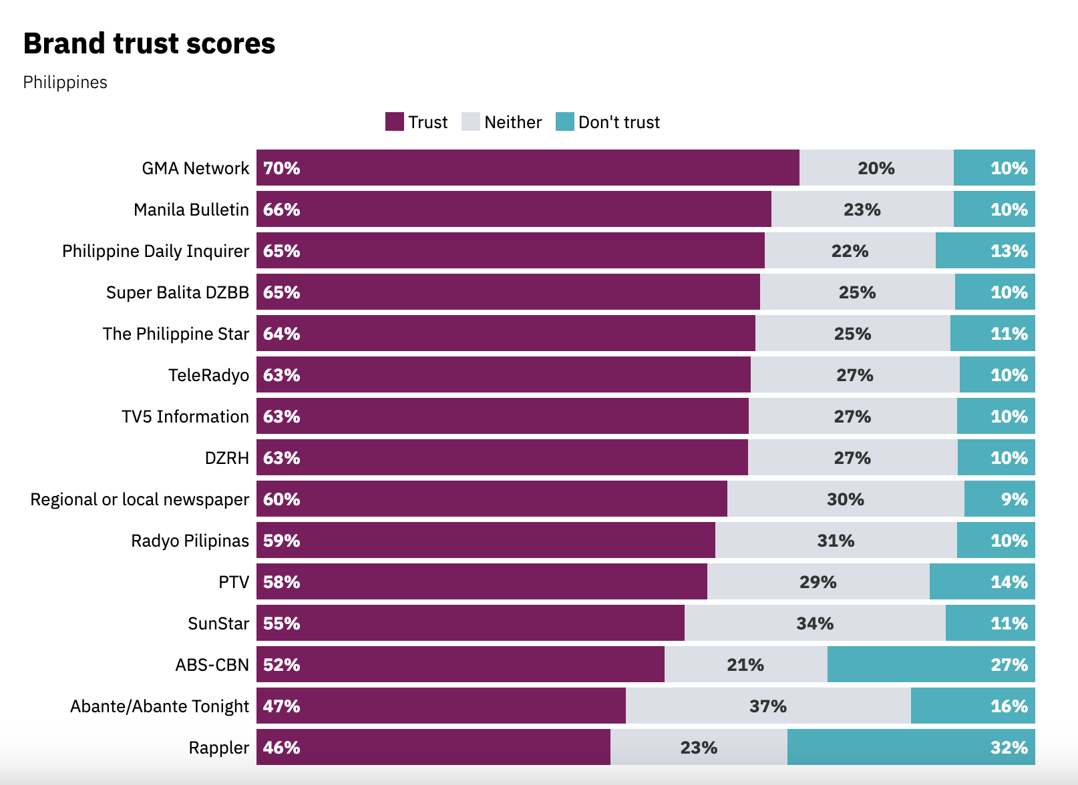
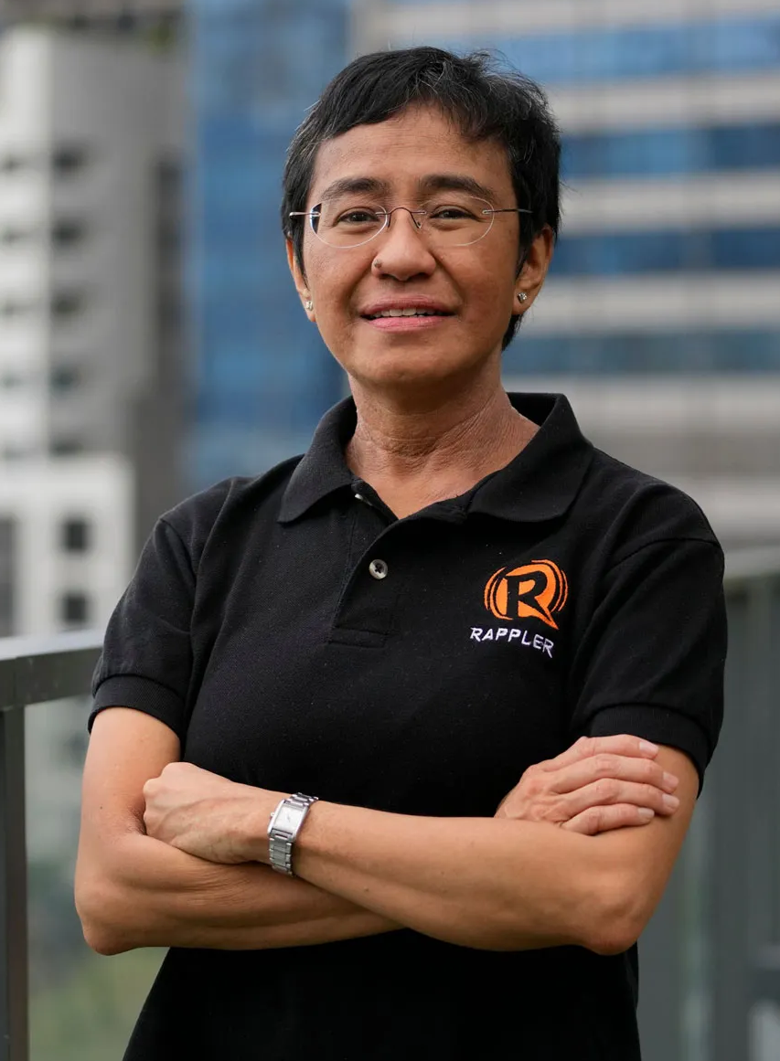

Slide 15
Transparency going forward?
Moral obligation
Accountability
Secondary trust-impact?
Risks of transparency

Slide 16
To what extent is trust in news based on what journalists do?
What level of trust is ideal?
Reading recommendations:
Michael Karlsson: Transparency and Journalism: A Critical Appraisal of a Disruptive Norm
Hugo Mercier: Not Born Yesterday: The Science of Who We Trust and What We Believe
My project will be published by the Reuters Institute this summer
jussi.latvala@gtc.ox.ac.uk (till end of June)
jussi.latvala@yle.fi

