Slide 1
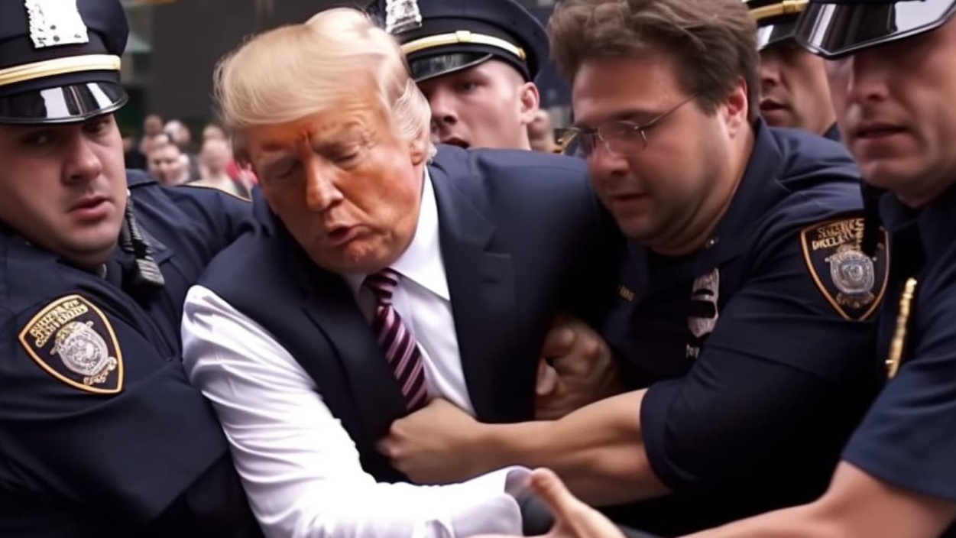
Dis/misinformation, manipulated photos
AI challenges for ombuds and standards editors

Slide 2

CLICK HERE TO PLAY VIDEO

Slide 3
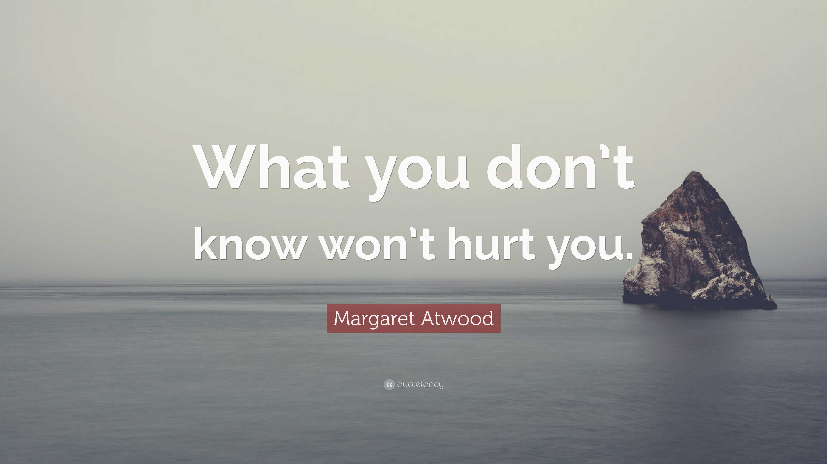
source: quotefancy.com
Notes:
What you don’t know, won’t hurt you… so they say…
It may be true about a lot of things on which I won’t elaborate here, but it is certainly not the case if we’re talking about AI.

Slide 4
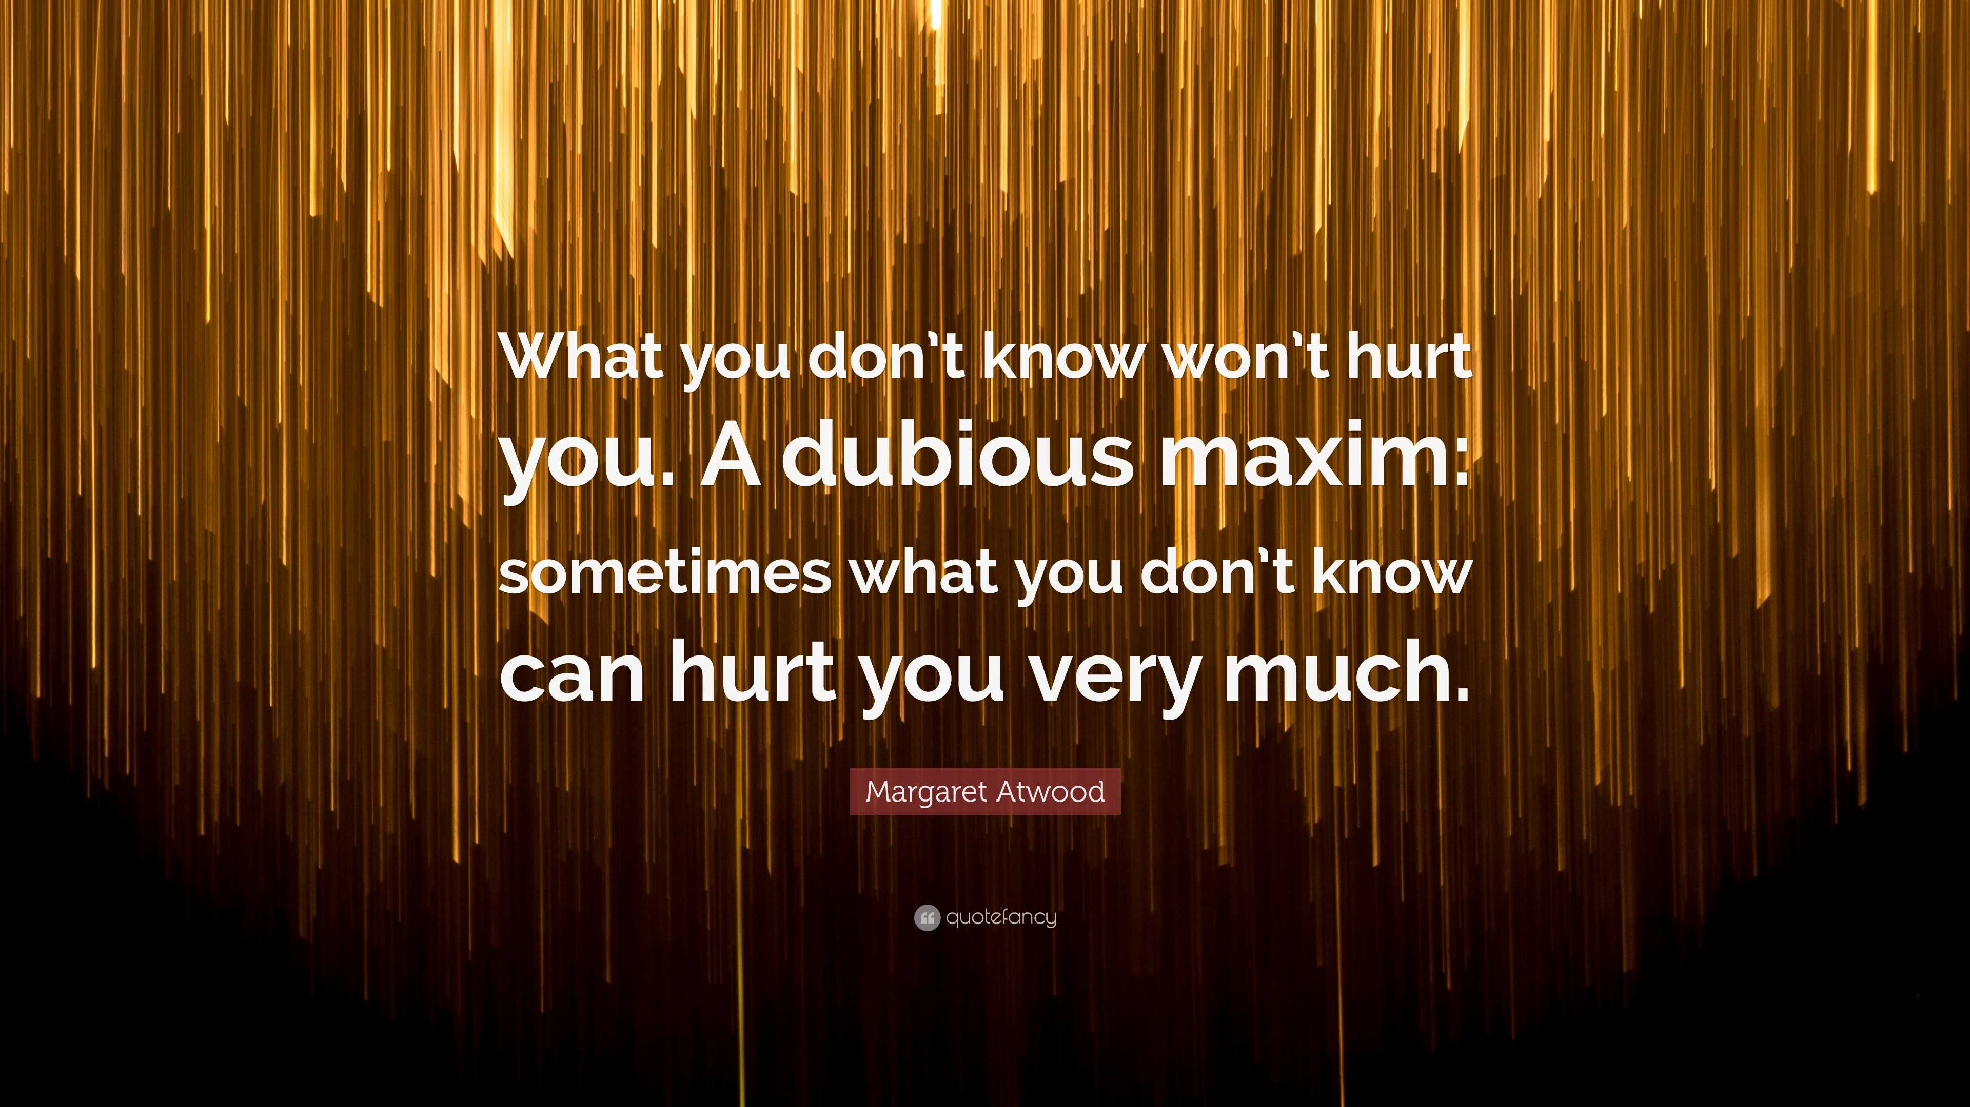
source: quotefancy.com
Notes:
Even Canadian novelist Margaret Atwood would agree, even though her novel dates back to almost 25 years, when AI was not part of our reality…

Slide 5
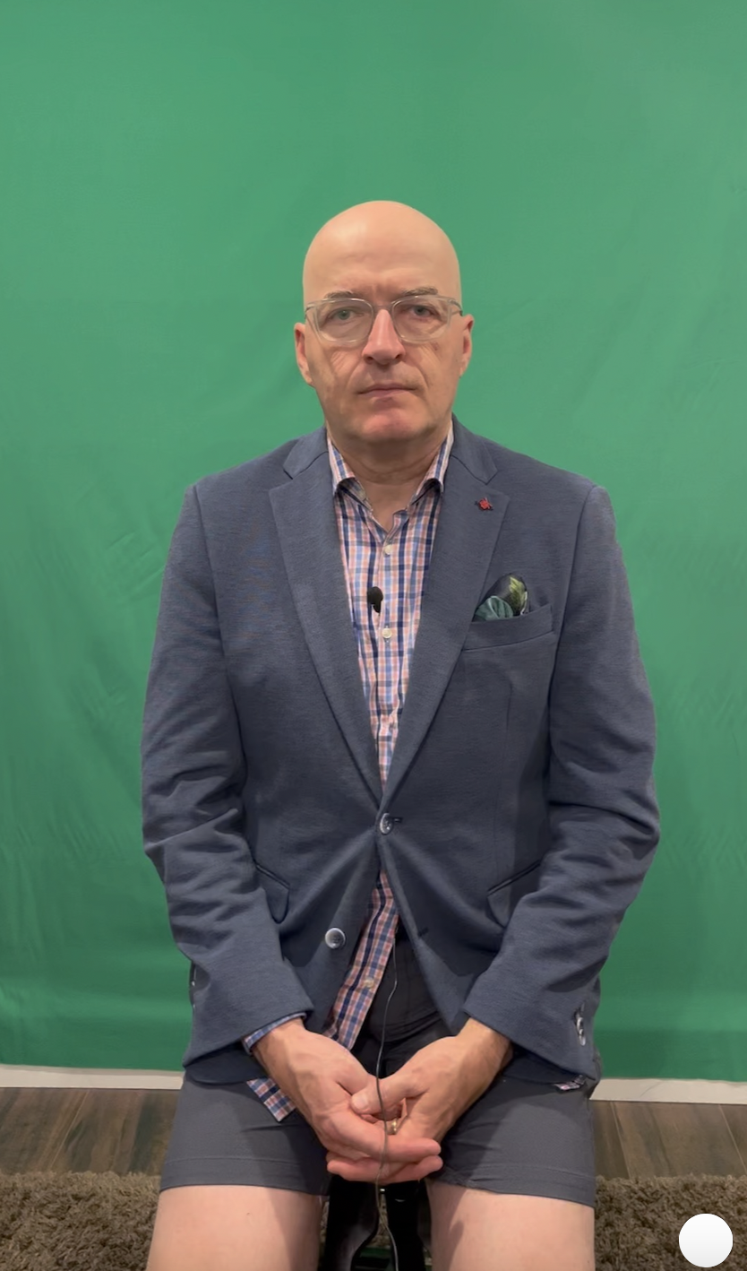
Notes:
You may have noticed that it wasn't the real me talking to you in this video. I created my avatar (in just a few minutes) with an iPhone and the HEYGEN app, and gave him a text to read to you, which you heard. Apart from the fact that he speaks much better English than I do, it's pretty amazing, especially for people who don't suspect that AI can create this kind of video. And there are a lot of them.

Slide 6
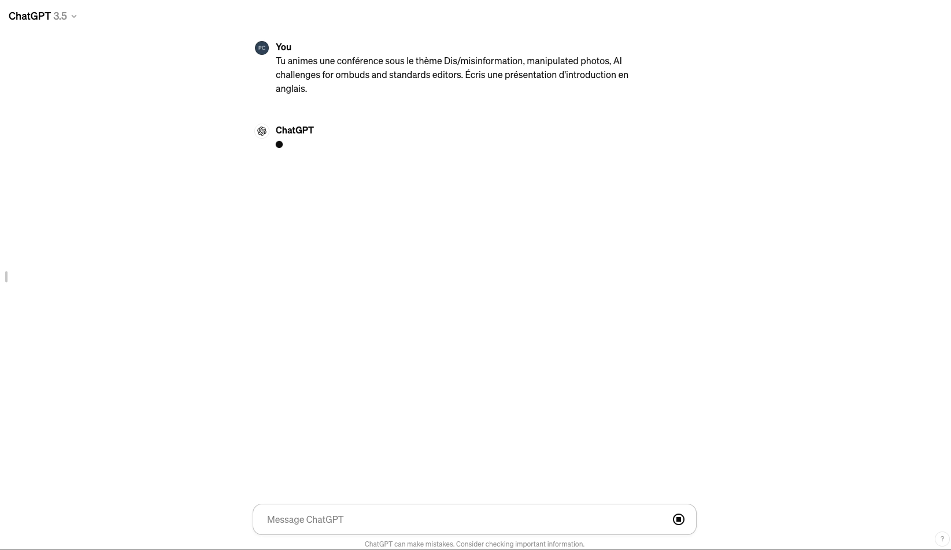
Notes:
Oh yes, the words you heard were also produced by the AI. I submitted this prompt, in French, to ChatGPT:
Tu animes une conférence sous le thème Dis/misinformation, manipulated photos, AI challenges for ombuds and standards editors. Écris une présentation d'introduction.

Slide 7
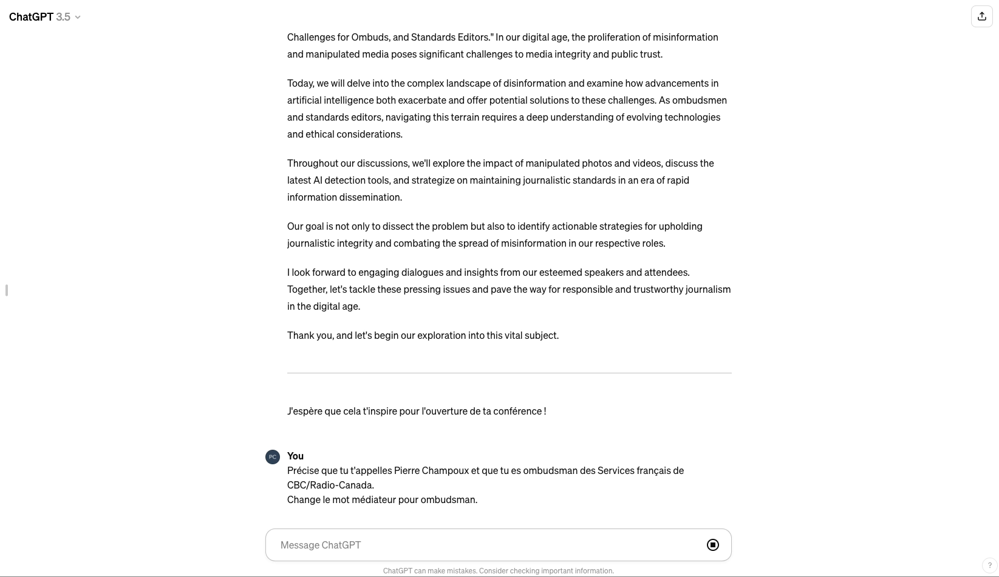
Notes:
What you've heard from my clone is 99% what Chat GPT proposed to me. Of course, like any good ombudsman and ex-journalist, I reread them and asked Chat GPT to make a few minor adjustments:
Précise que tu t'appelles Pierre Champoux et que tu es ombudsman des Services français de CBC/Radio-Canada.
Change le mot médiateur pour ombudsman.
In fact, the first version supplied was excellent.

Slide 8
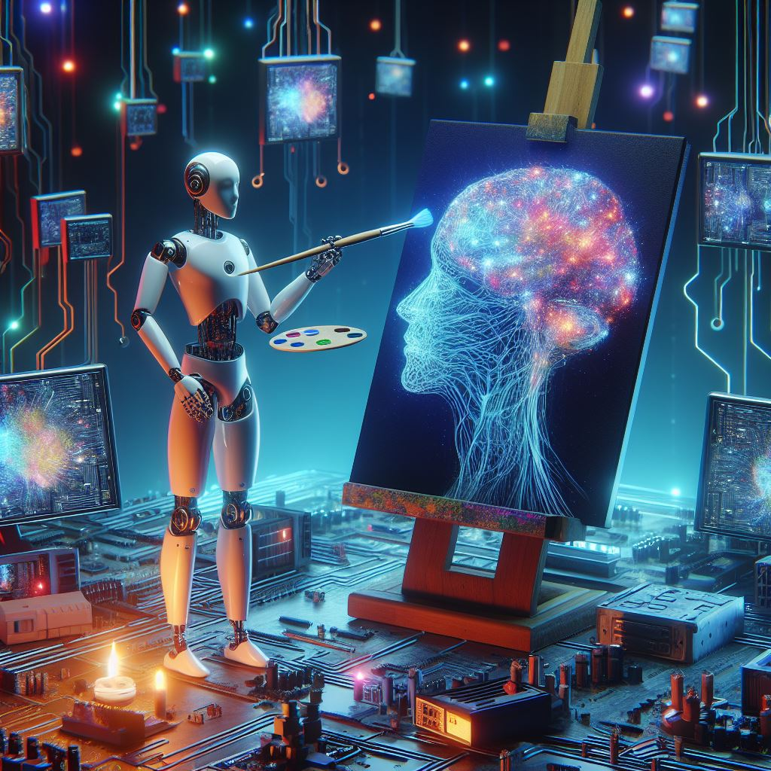
source: Copilot
Notes:
I don't know about you, but I think it's absolutely sensational and extremely frightening at the same time.
There were probably a few clues that tipped you off, like the fact that I speak several languages almost perfectly. Or that we're here to talk about AI.

Slide 9
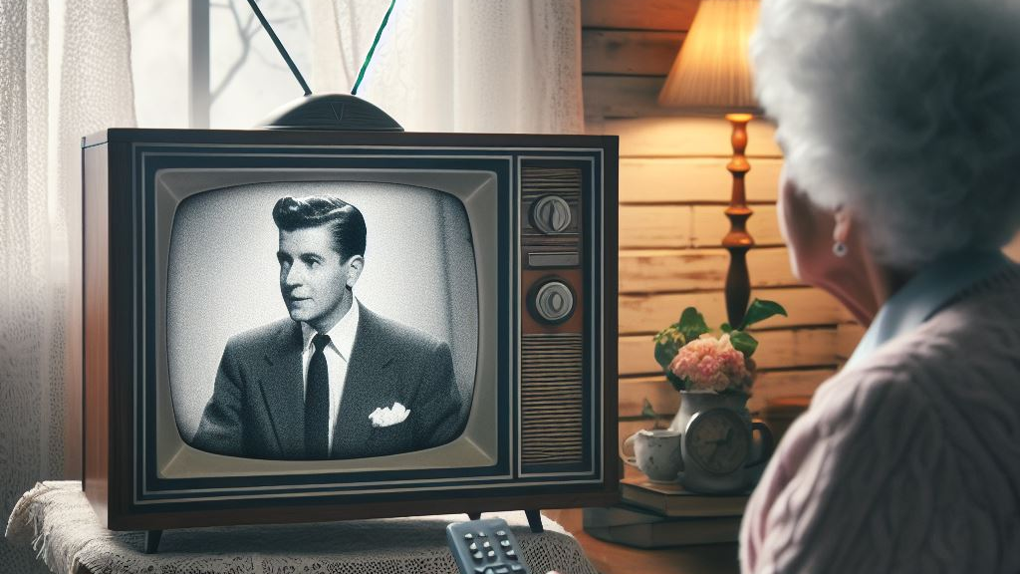
source: Copilot
Notes:
But that wouldn't have aroused the suspicions of someone who didn't know me and, more importantly, didn't know that AI existed...

Slide 10
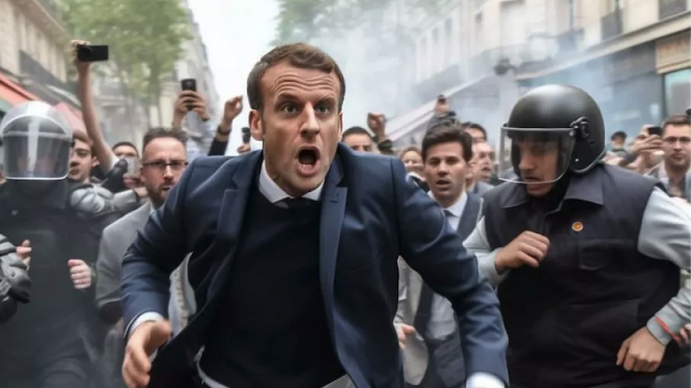
source: Midjourney
Notes:
…let alone what it can achieve.
Disinformation, misinformation, fake videos and images.
This threat is already very real, but how can we detect it and prevent ourselves from participating in the dissemination of false or misleading information?

Slide 11
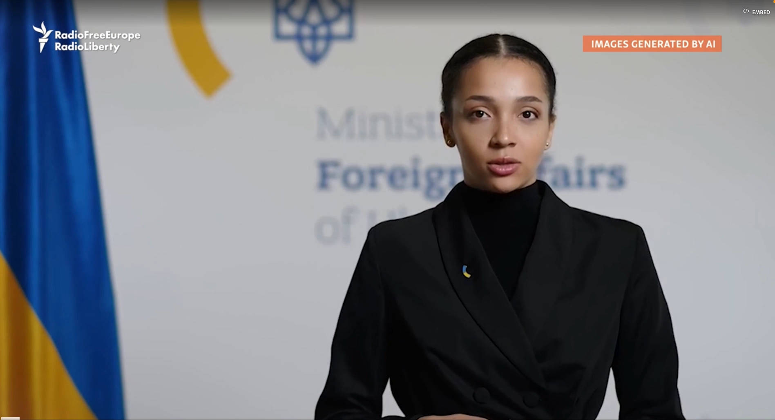
Source: Radio Free Europe
Notes:
How can you tell propaganda from fact?

Slide 12
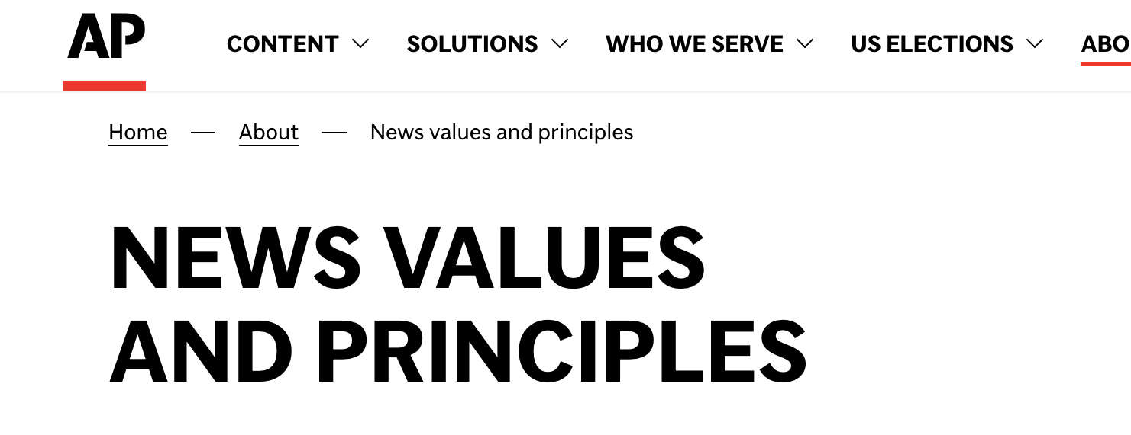
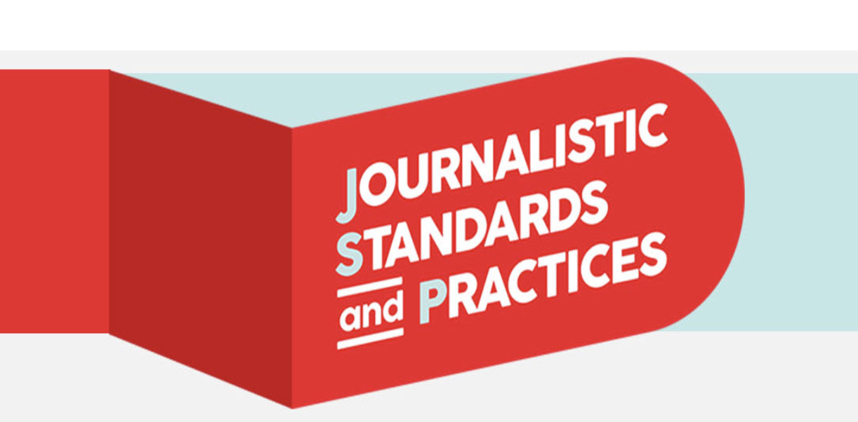
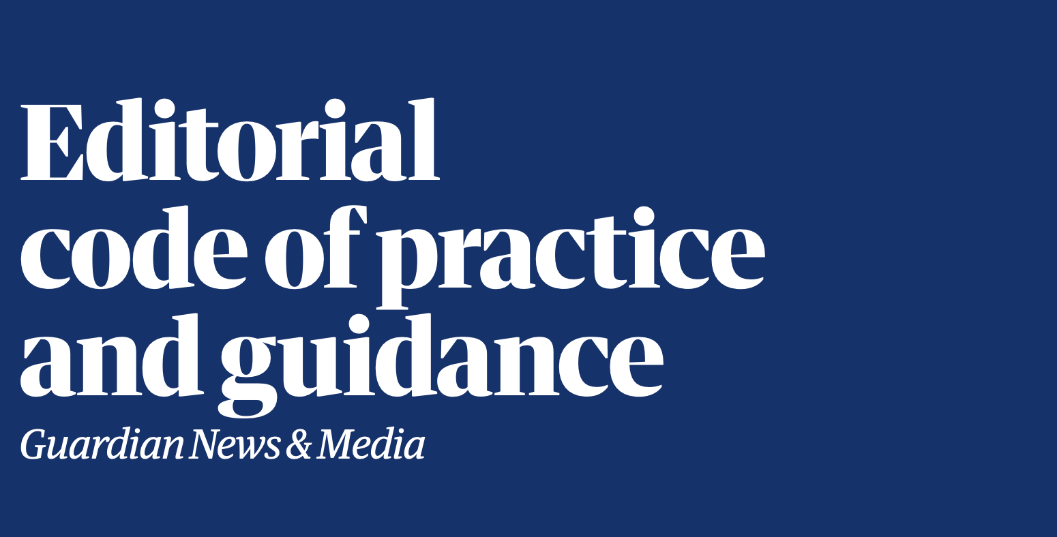
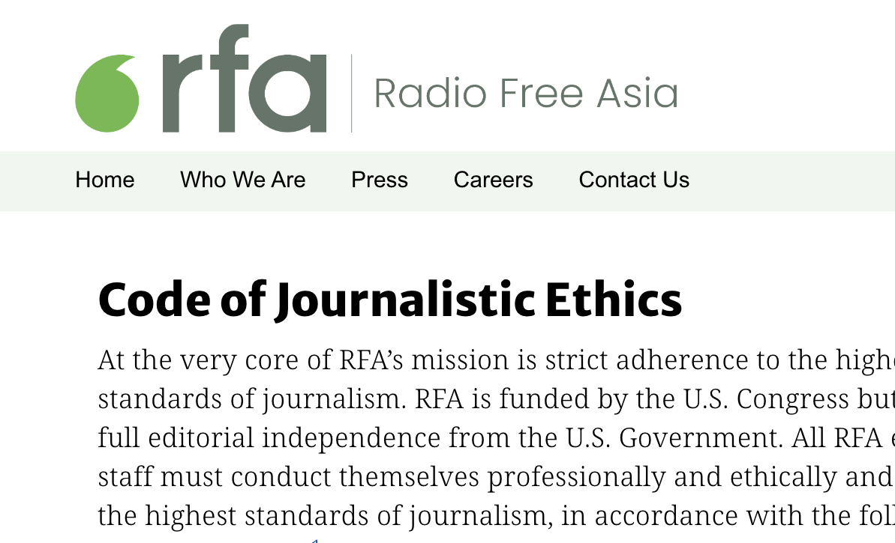
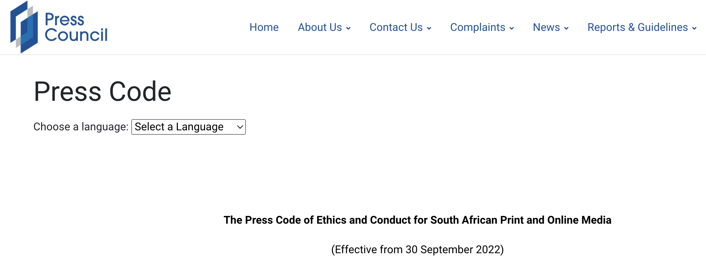
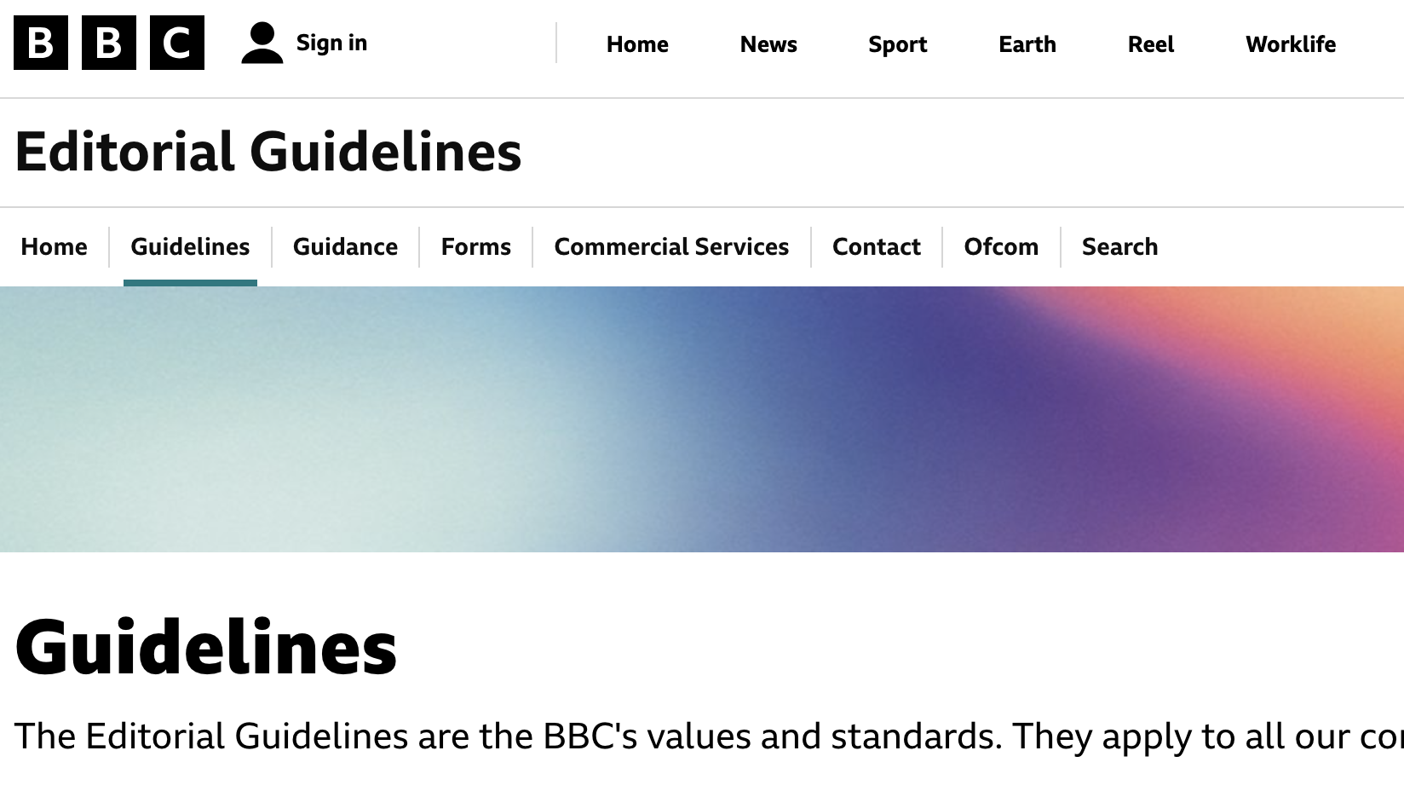
Notes:
Are our journalistic standards and practices ready for this new, artificial reality?
Several media outlets have already amended their standards, but is this enough? Are they on the right track?

Slide 13
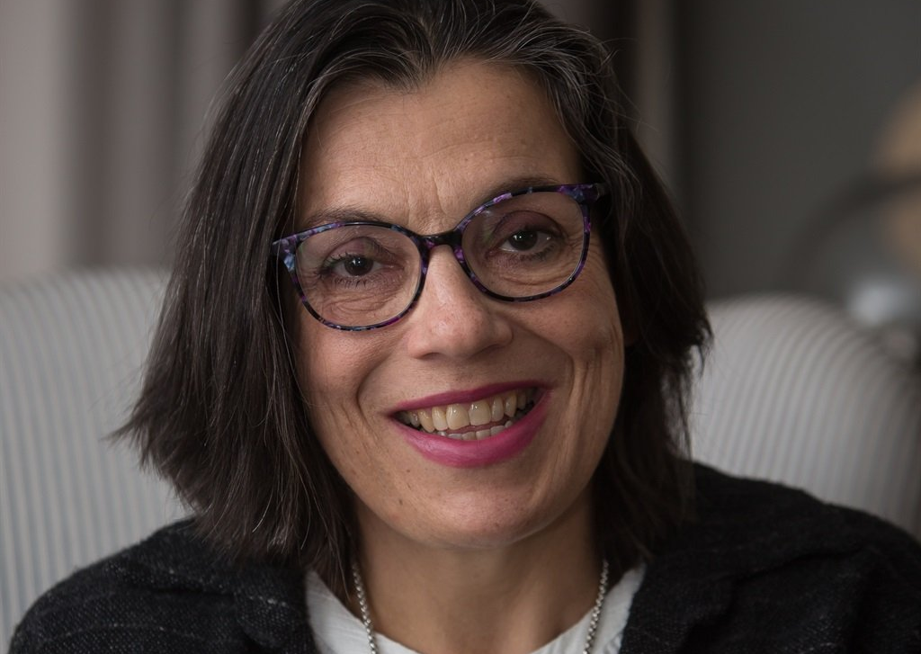
Arlene Prinsloo
Sub-editor, page designer, redesigner for newspapers
Web editor for Media24 for 33 years.
Passionate about combining visuals with the written word for the ultimate reading experience.
Notes:
With me...
Arlene Prinsloo
worked as a sub-editor, page designer, redesigner for newspapers and web editor for Media24 for 33 years. She is passionate about combining visuals - graphics, videos, photographs and social media embeds - with the written word for the ultimate reading experience.

Slide 14
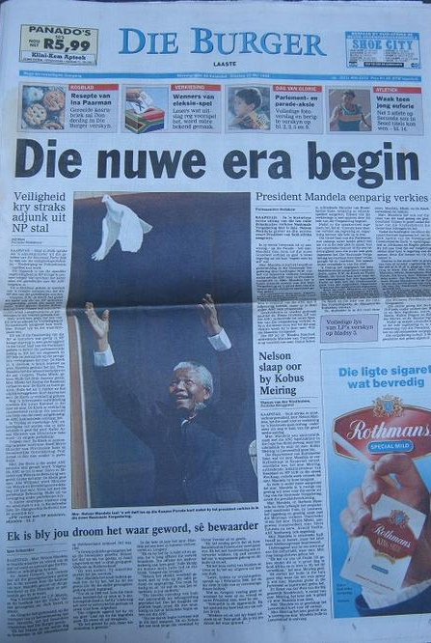

Slide 15
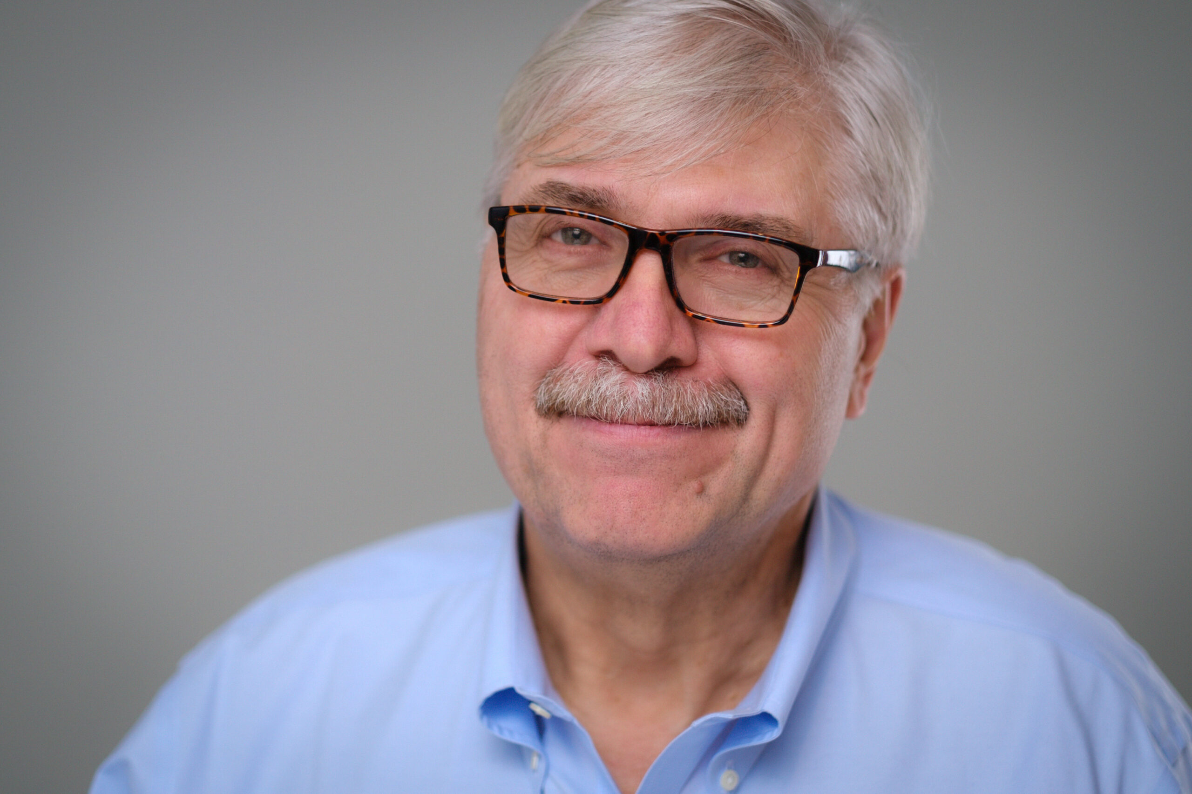
John Daniszewski
AP’s vice president for standards and editor-at-large since 2016
International editor, senior managing editor and vice president for international news.
Reporter, editor and correspondent for The Associated Press and the Los Angeles Times.
Notes:
John Daniszewski (daniJEVSki)
He's been AP’s vice president for standards and editor-at-large since July 2016, after more than a decade leading its international news department as international editor, senior managing editor and vice president for international news. Prior to that, he spent 20 years as a reporter, editor and correspondent for both The Associated Press and the Los Angeles Times. He has worked in more than 70 countries in Europe, Africa, the Middle East, Latin America and Asia. As AP’s vice president for standards, John oversees the implementation of its news values and principles, working with the staff in all formats to maintain AP’s reputation for accuracy and neutrality across the news cooperative’s worldwide bureaus.

Slide 16
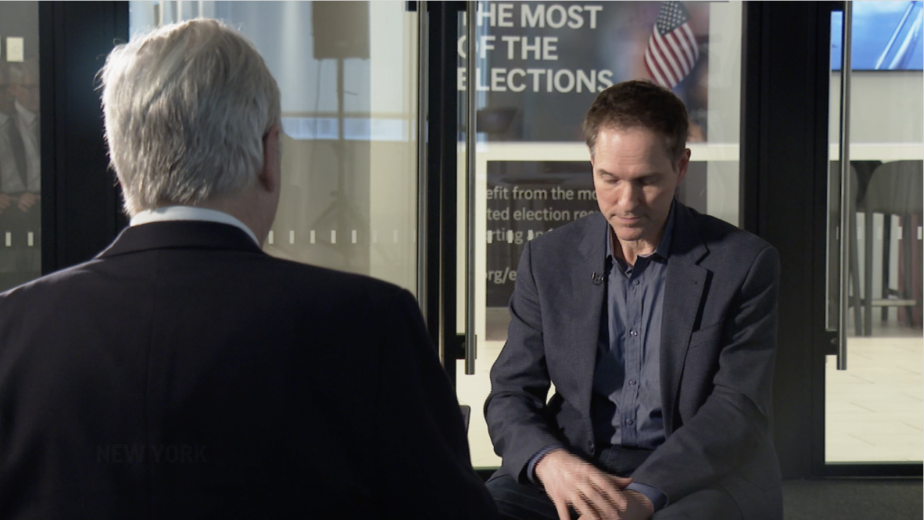
CLICK HERE TO PLAY VIDEO

Slide 17
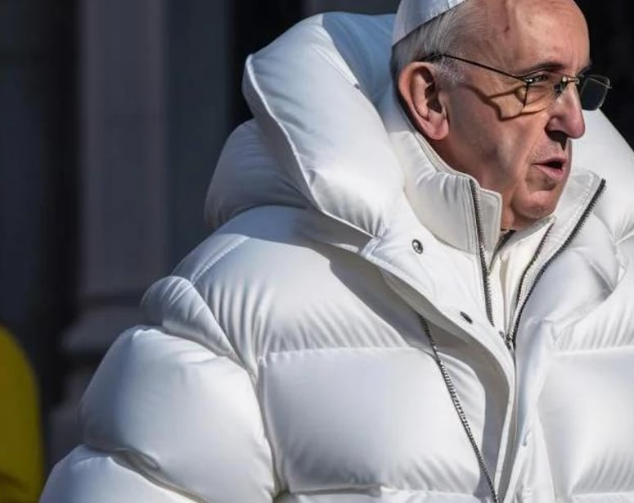
Dis/misinformation, manipulated photos
AI challenges for ombuds and standards editors

